Slide 1
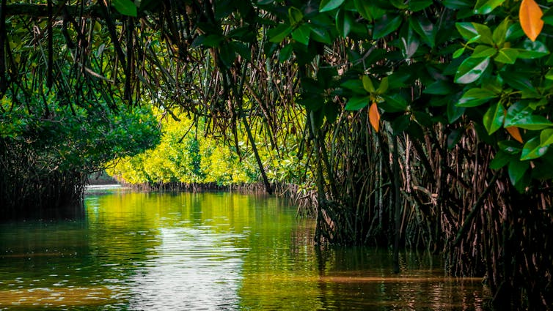
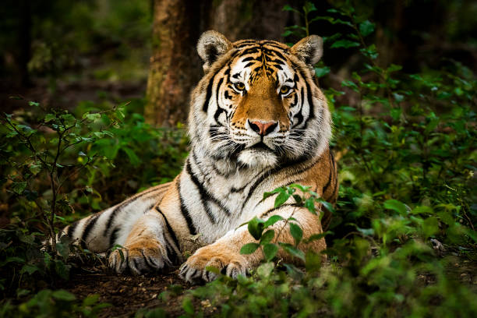
Coastal Change Detection of Henry and Lothian Island Using Multi-Year LULC Analysis and K-Means Clustering
This Photo by Unknown Author is licensed under CC BY-SA

Slide 2
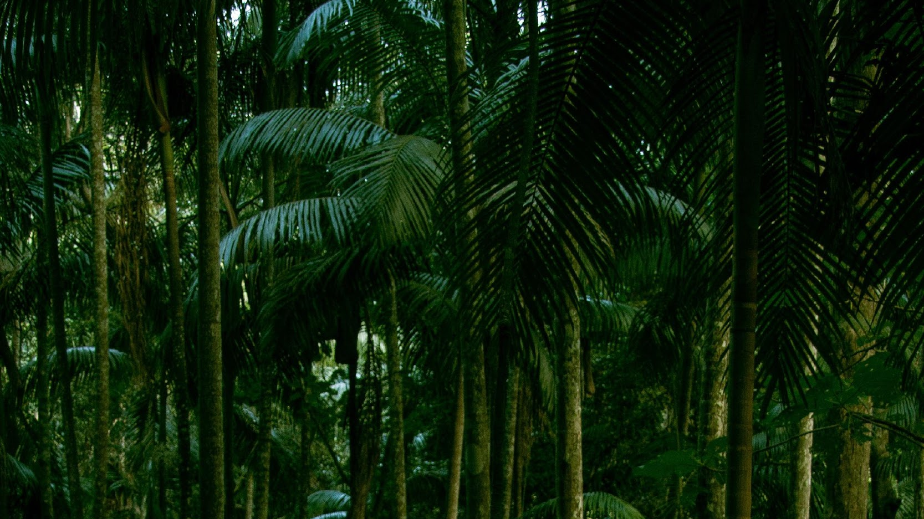
Objectives
Identify spatial patterns, trends, and hotspots of coastal change using K-means clustering analysis.
Provide scientific insights to support conservation planning and adaptive management of vulnerable coastal ecosystems.
Detect and quantify land use/land cover (LULC) changes in Henry and Lothian Islands across multiple years using satellite imagery.

Slide 3
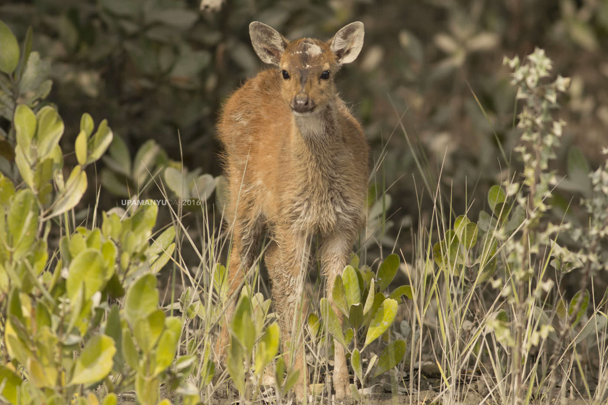
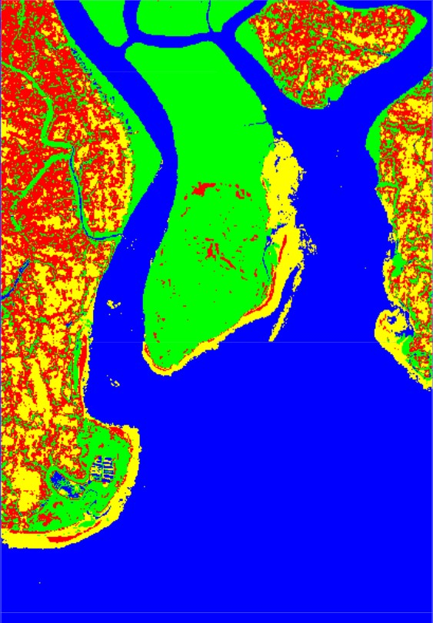
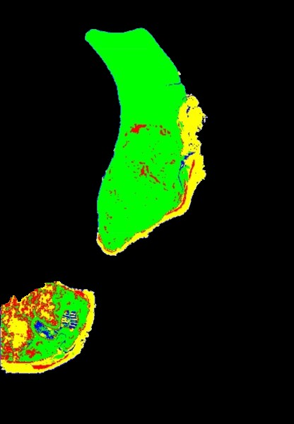
Methodology
1.
Selected the region of interest in the Sunderban area, focusing on Lothian and Henry Islands.
2.
Classified four land use/land cover features for each year from 2014 to 2023.
3.
Separated out the Lothian and Henry Islands from the full region to create 10 yearly images.
4.
Used these 10 images as input for a change detection algorithm to analyze patterns and trends over time.
5.
Collected and summarized the outputs to understand how the islands have changed and to help in future planning

Slide 4
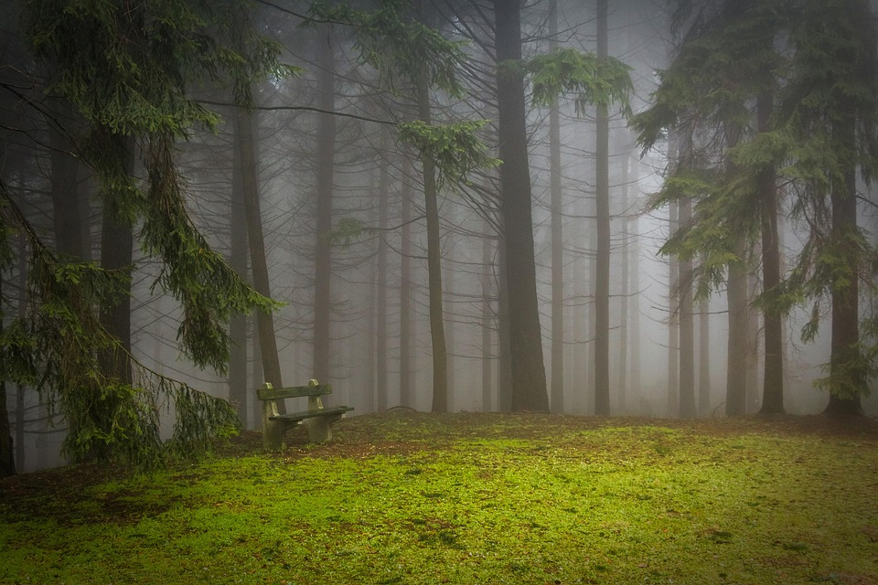
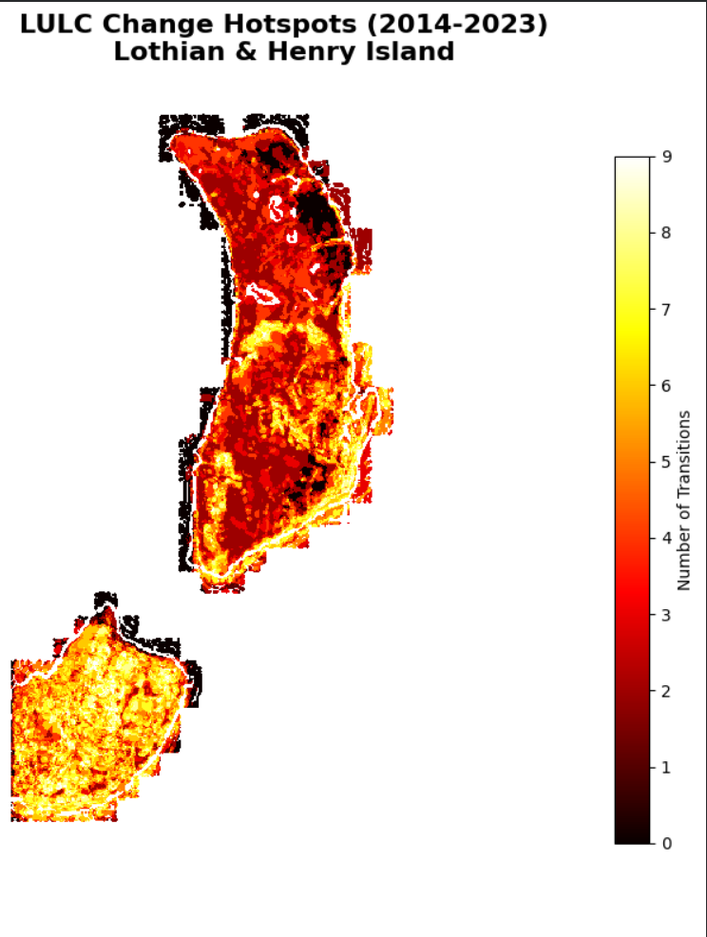
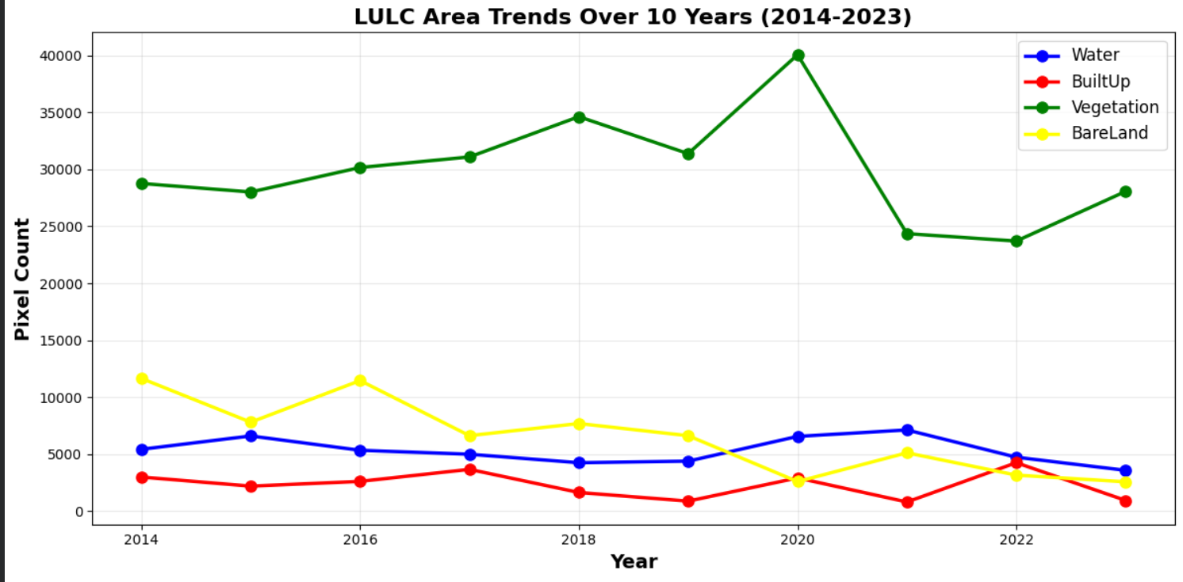
Results

Slide 5
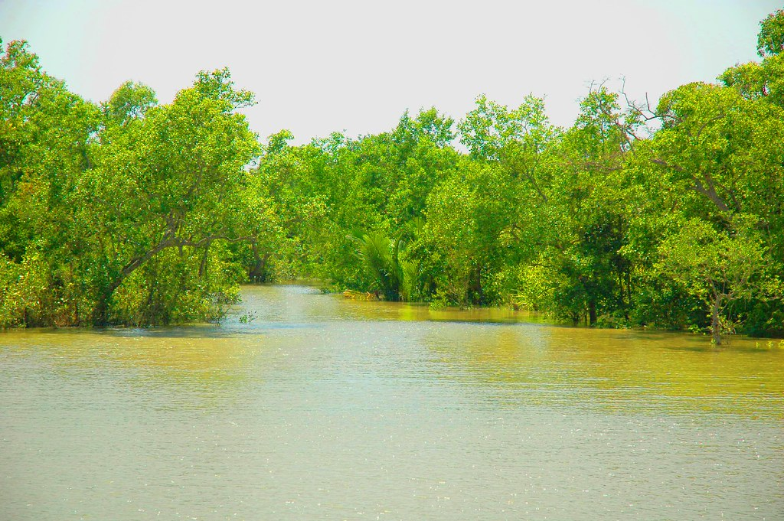
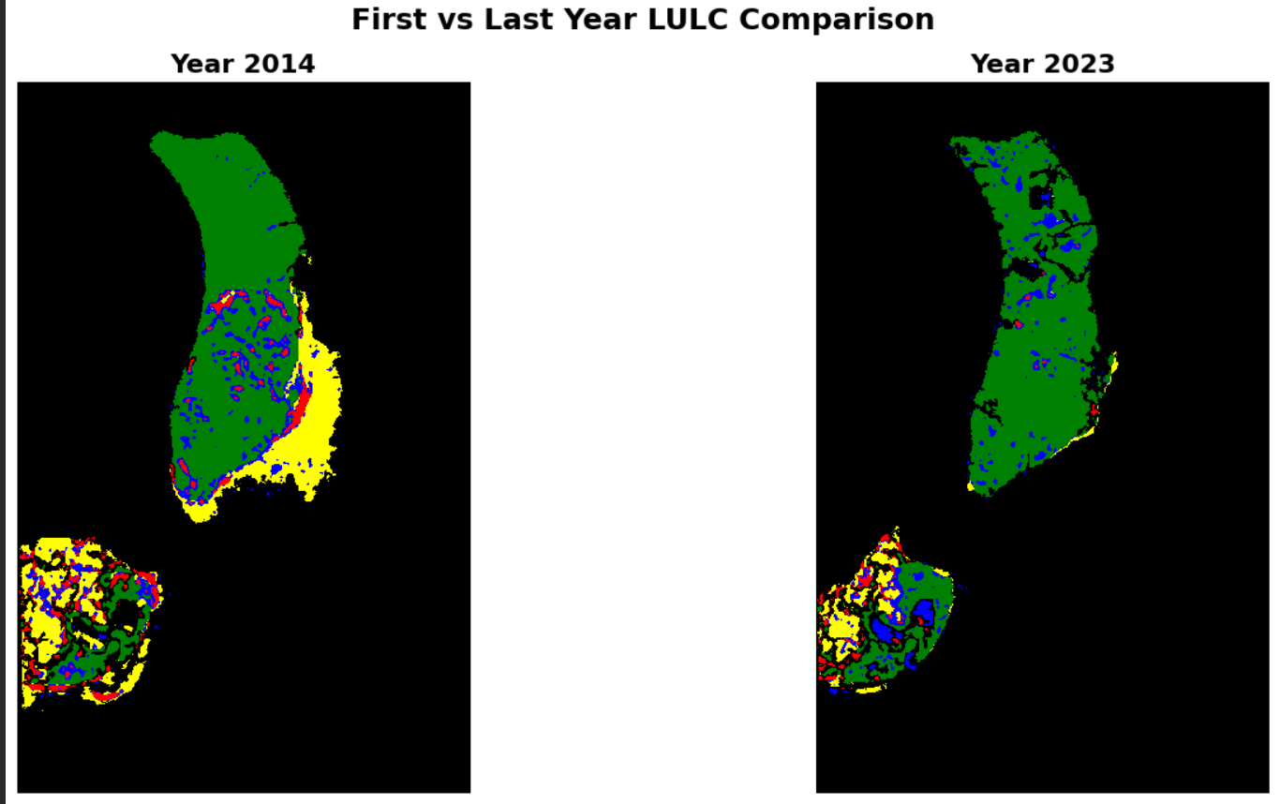
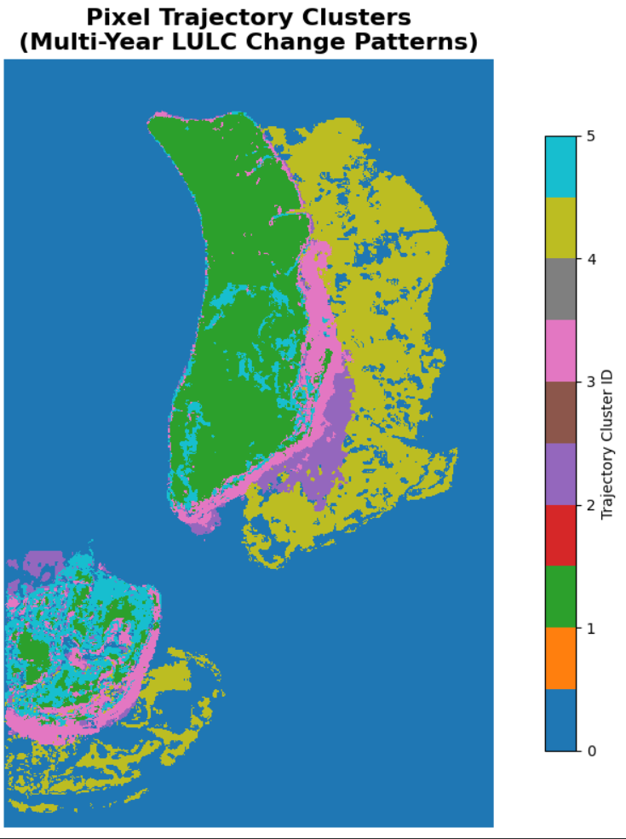

Slide 6
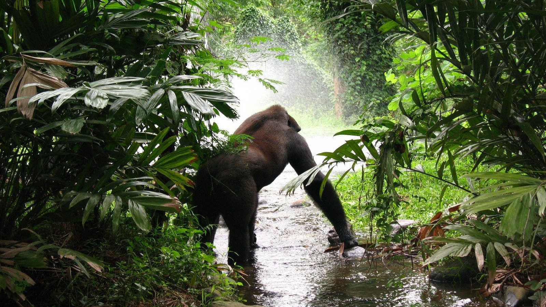
Conclusion
Using 10 years of images helped spot important trends and sudden changes after major events like cyclones.
Separating and analyzing each year gave a clearer view of which places were most dynamic or stable.
This analysis supports better planning, conservation, and management strategies to protect these vulnerable islands in the future.
This project approach can be used for monitoring other sensitive coastal regions as well.

Slide 7
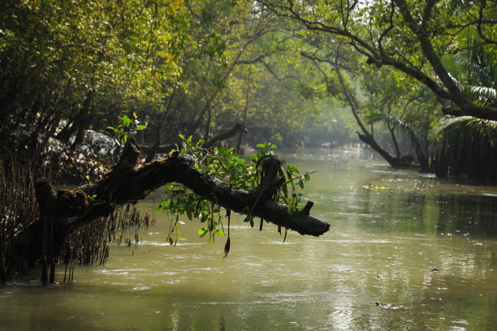
Thank You

